Slide 1
Data Science Course
Lecture 12

Slide 2
How do we estimate the performance of a machine learning model?

Slide 3
Why do we care about performance estimates at all?
How well the model performs on unseen data.
Tuning of the internal knobs of a learning algorithm (result: different models).
Compare different algorithms to each other (predictive and computational performance).

Slide 4
Why do we care about performance estimates at all?
In common: we want to estimate the performance of a model.
They all require different approaches.

Slide 5
Assumptions and Terminology
We assume that our samples are i.i.d (independent and identically distributed).
Supervised learning.
Bias.
Variance.

Slide 6
Assumptions and Terminology
Target function: f(x)=y
Hypothesis.
Model.
Learning algorithm.
Classifier.
Regressor.
Hyperparameters.

Slide 7
Holdout Method
Simplest model evaluation technique.
We split our labeled dataset and it into two parts: A training set and a test set.
Fit a model to the training data and predict the labels of the test set.
Fraction of correct predictions constitutes our estimate of the prediction accuracy.
Withhold the known test labels during prediction!

Slide 8
Problems
Stratification

Slide 9
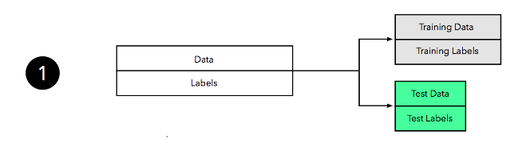

Slide 10
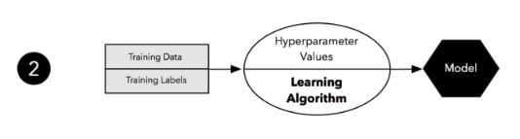

Slide 11
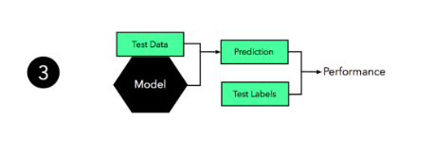

Slide 12
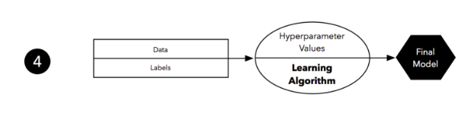

Slide 13
Problems
Pessimistic Bias

